Slide 1
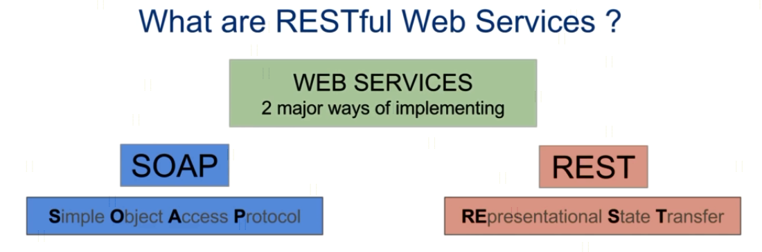
What are REST Web Services?
Request
Client
(Service Consumer)
Server
(Service Provider)
Response

Slide 2
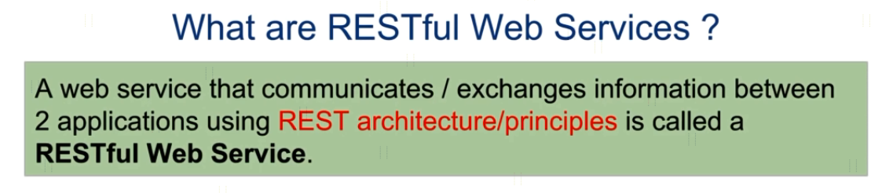


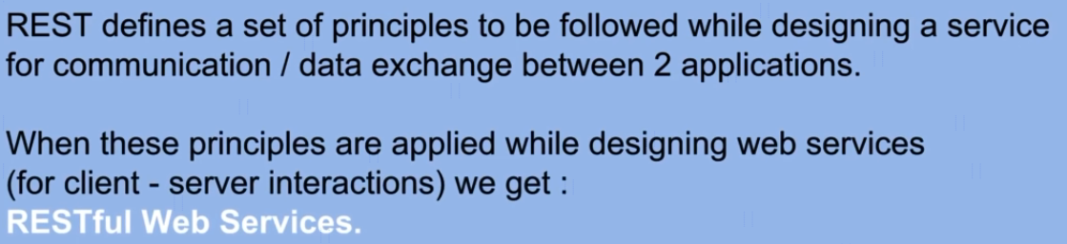
What are REST Web Services?

Slide 3
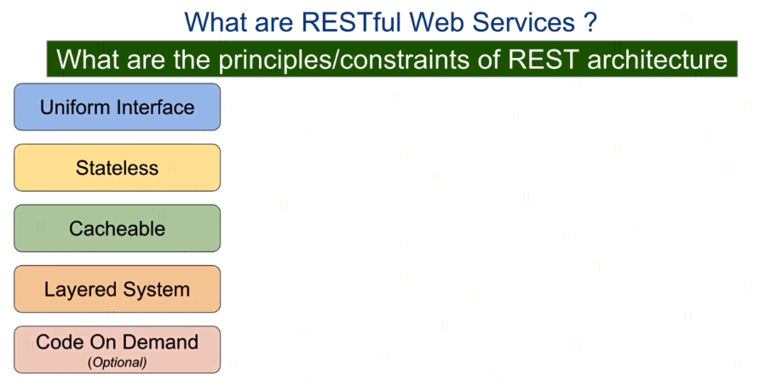

What are REST Web Services?

Slide 4
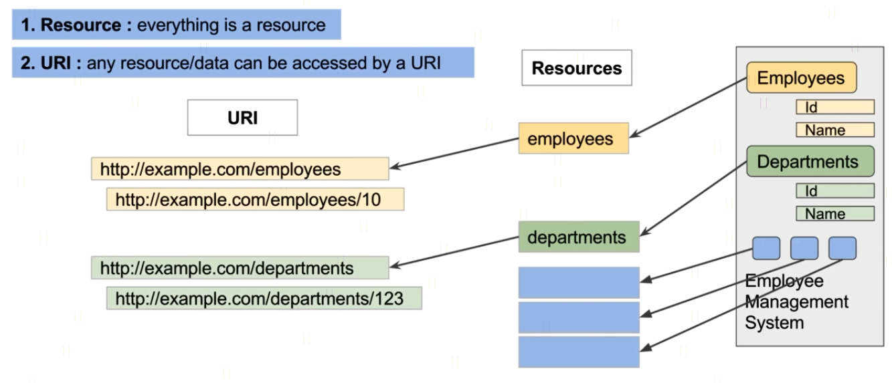
What are REST Web Services?

Slide 5
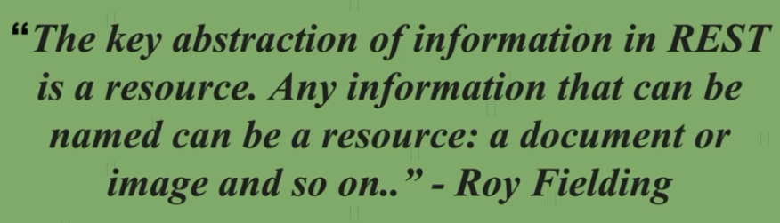
What are REST Web Services?

Slide 6
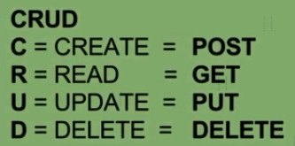
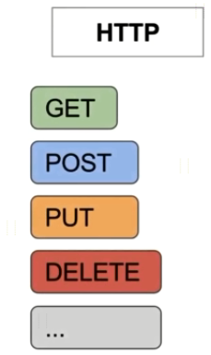
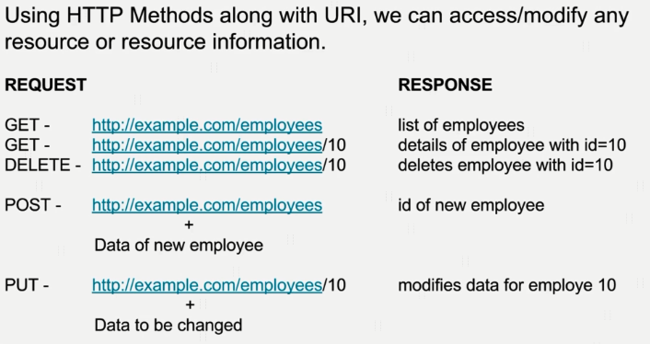
What are REST Web Services?

Slide 7
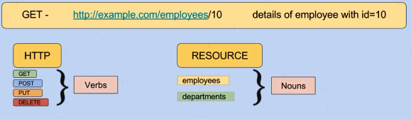
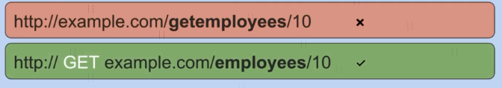
What are REST Web Services?

Slide 8
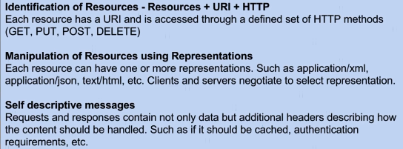
What are REST WebServices?

Slide 9
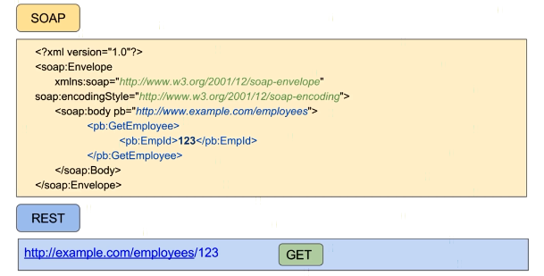
What are REST WebServices?
Thomas bayer site

Slide 10
HTTP Message Structure
https://www.udemy.com/course/web-services-api-step-by-step-beginner-tutorial/learn/lecture/10047726#notes

